Slide 1
Research on Visualizations
Neil H. Schwartz, Ph.D.
Professor of Psychology
California State University, Chico

Slide 2
Visualizations Defined
Visualizations refer to the 2D and 3D static and animated visual
displays that depict conditions, situations, processes, places
or events as they appear in maps, diagrams, graphs, pictures,
schematics, data-based spatial or linear renditions, and
immersive virtual environments, (IVE’s).
For example…

Slide 3
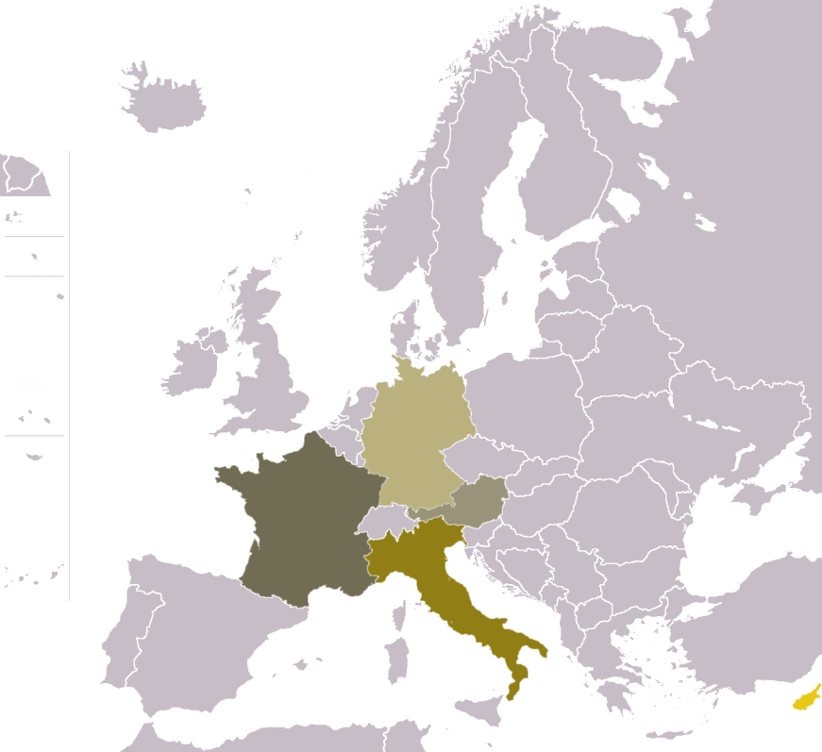
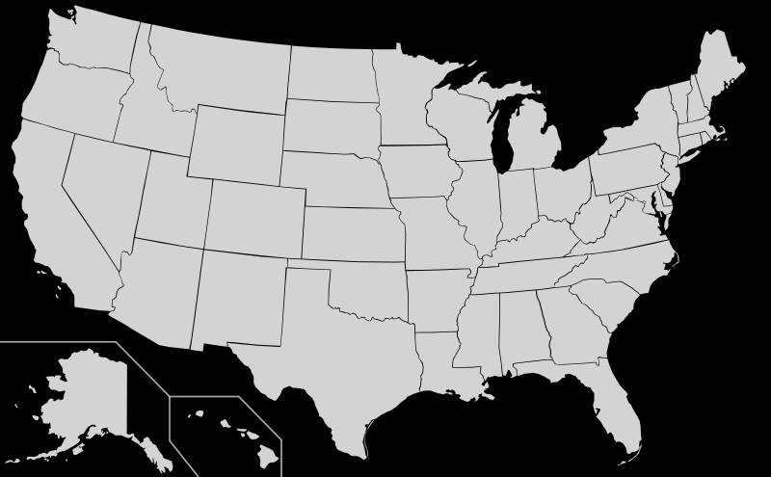
Maps

Slide 4
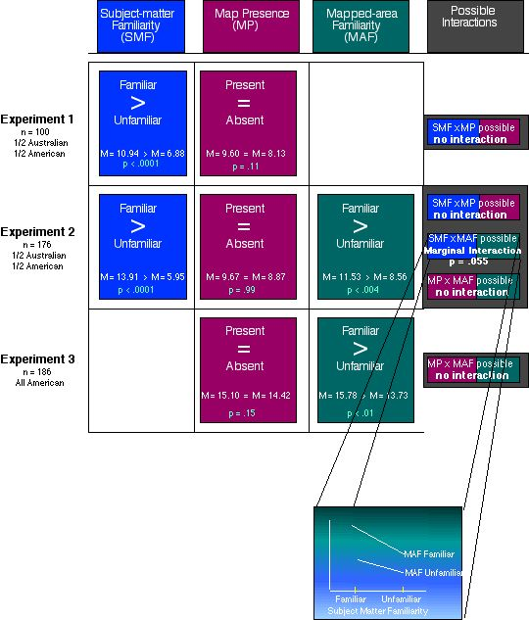
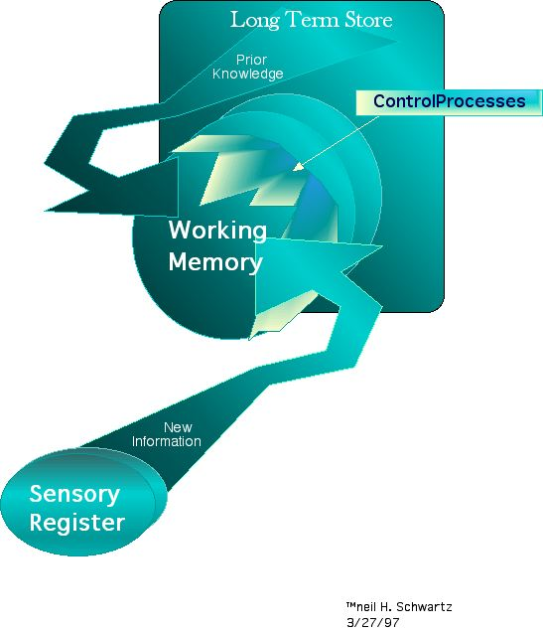
Diagrams & Charts

Slide 5
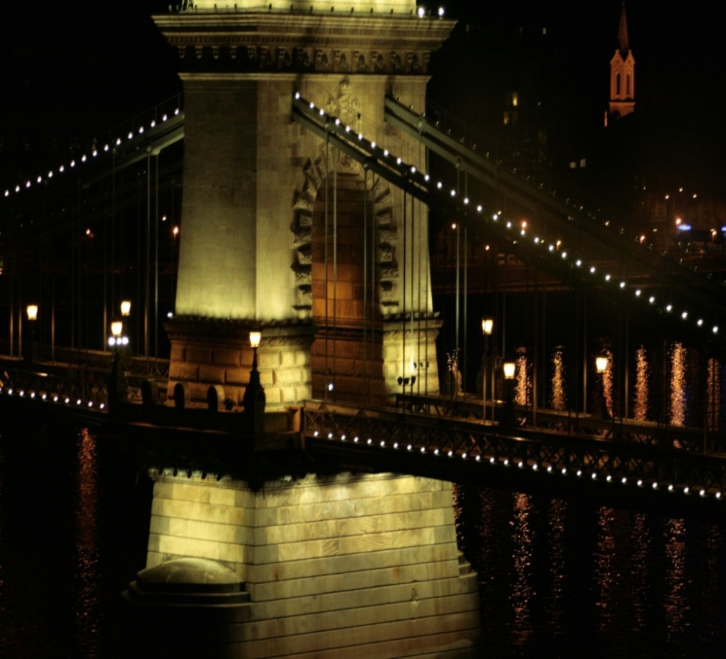
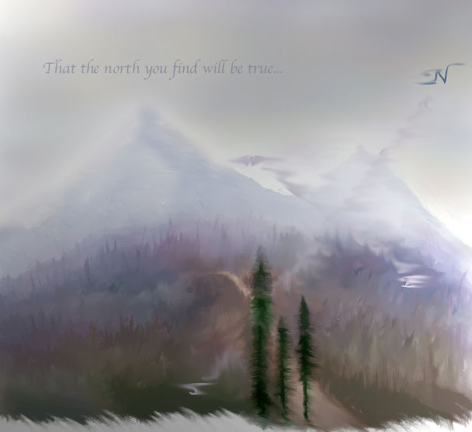
Pictures

Slide 6



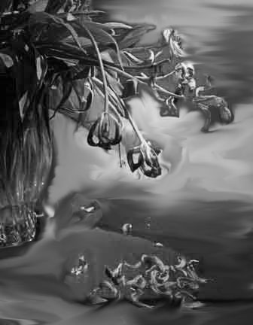
Pictures: Can reveal a theme

Slide 7
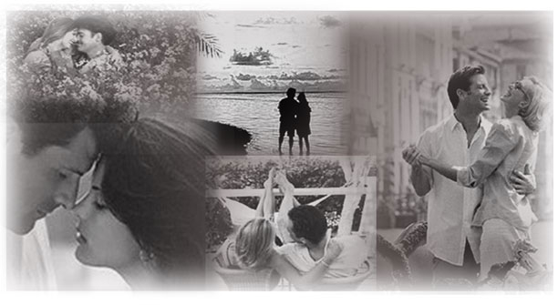



Slide 8
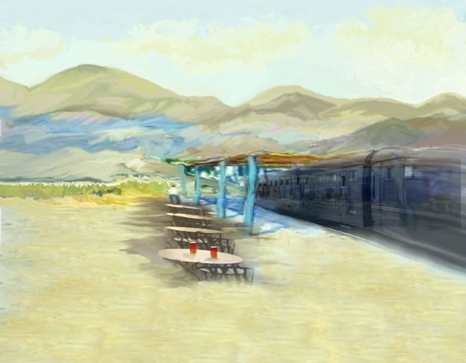
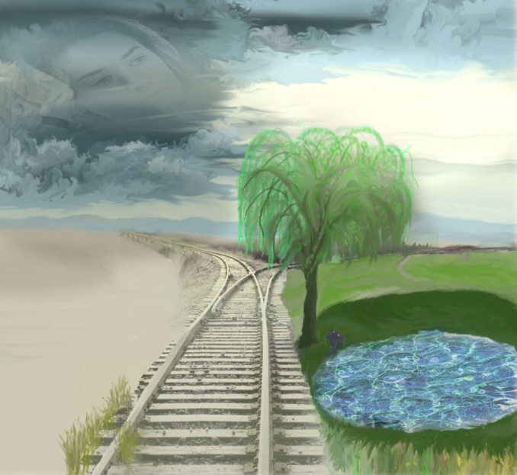
Pictures: Can show a metaphorical relationship

Slide 9
Our Recent Research
Pictures
Text
SET I: Study 1, 2, 3
Manipulated pictures to influence theme.
SET II: Study 4
Manipulated pictures to persuade political position.
SET III: Study 5
Manipulated pictures as visual metaphors to reveal theme.

Slide 10
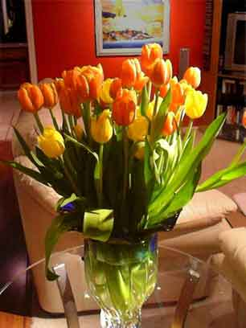
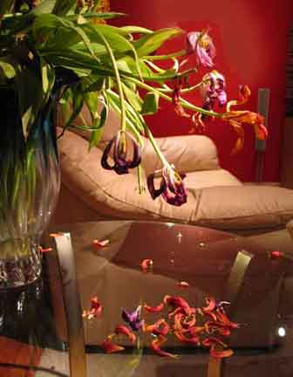


SET I: Shifting Perspective on Theme
We all have experiences in
relationships-- from the
attachments we build with our
parents to the platonic and
romantic connections that emerge
later in life. We develop these relationships which continue to grow from the time we are young until we are old. These relationships can range anywhere from friendly and supportive to love and romantic. It is these last types of relationships, romantic ones, in which we are interested below. Recent studies about romantic relationships have revealed a variety of interesting findings in regards to the way individuals perceive these romantic relationships.
During the period in which two people enter a new relationship, there is typically an initial, exhilarating period when the couple engages in intense exploration and conversation. However, after the initial feeling of elation subsides, one or both of the individuals may find the relationship too constraining, or find the differences in personalities too inconsistent. Still couples often do seem to find the dynamics of the relationship well-suited to the extent that they pursue…
Experimental Passage
Graphic Theme
Uplifting Growing
Melancholy Dying
Literal
Graphic
Context
Figurative

Slide 11
Set 1: Expectations
We wanted to know whether decorative graphics that are related to the content of a passage by theme influence what is learned from the passage. Specifically, we expected the theme of a decorative graphic would make:
  1. Some passage content more important than others.
  2. Make important passage content more memorable.
  3. Influence the perspective a learner takes on a passage.

Slide 12
Set 1: Findings
The data supported our expectations.
When a figurative graphic showing a melancholy theme accompanies text, students bring in less information from the text into their essays. F (1,76) = 3.69, p = .05
When a graphic showing an uplifting theme accompanies text, students bring in more personal information into their essays. F (1,76) = 4.76, p = .03

Slide 13
Set 1: Expectations
We also expected the theme of a decorative graphic would bring out prior knowledge consistent with the perspective influenced by the graphic theme.

Slide 14
Set 1: Findings
After viewing the
melancholy graphic.
  Males’ feelings at the time of the dissolution of their last relationship and their aesthetic judgment of the picture predicted 87% of the variance of the positive statements they included in their essay.
  Females’ current satisfaction in their last relationship and their aesthetic judgment predicted 30% of the variance of the non-personal positive statements they included their essay.

Slide 15
Set 1: Findings
After viewing the
melancholy graphic.
For males, the poorer their feelings of their last relationship, and the better their current one, the more positive statements they included in their essay after viewing the melancholy graphic.
However, the more beautiful males perceived the melancholy graphic, the more positive statements they included in their essay. In total, both variables accounted for 98% of the predicted variance.
For females, the more beautiful they perceived the melancholy graphics, the more emotionally negative statements they included in their essay after reading.

Slide 16
Set 1: Findings
After viewing the
uplifting graphic.
Only females were influenced
by the uplifting graphic:
The more satisfied females were in their current relationship and the more beautiful they perceived the graphic, the less negative personal statements they included in their essay.

Slide 17
Set 1: Conclusions
Pictures influence what people think about when they read a text.
They influence what personal memories people mix with what they read.
They influence what people remember from what they read.
People have a hard time telling the difference between what they read and what they bring from memory when they read.

Slide 18
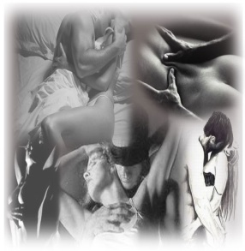
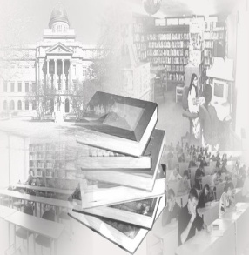

Set II:
Persuasion
Recent studies have shown that among developed nations, the US ranks the highest in adolescent pregnancies, births, and abortions. To deal with this problem among our youth, many school systems have adopted one of two different forms of sex education: abstinence or safe-sex programs.
A key component of abstinence-only programs are that a person with moral standards must wait until marriage to engage in sexual activity. Proponents of abstinence programs argue that waiting until marriage shows a higher moral standard and a greater respect for one's partner.
Promoters for safe-sex programs argue that it is ridiculous and dangerous to expect that simply telling a teenager not to have sex will be effective. They argue that teenagers, and people in general, are naturally prone to be curious and interested in sex, and suppressing those natural instincts could cause more harm than help.
None
Individualist Perspective
Collectivist Perspective

Slide 19
Set II: Findings
p < 0.05
Learners reading the passage in the presence of the romantic graphic made significantly more endorsements of safe sex if they think in a more collectivist fashion than if they they think more individualistically.

Slide 20
Set II: Findings
Learners who think more individualistically provided significantly more evidence of physical relationships to support their position on sex education when they read the passage in the presence of the provocative graphic.

Slide 21
Set 2: Conclusions
Pictures influence the amount of evidence people use to support a position on an issue if they are more collectivist thinkers. But, the pictures will not change the people’s pre-existing beliefs about the issue.
Pictures will influence the type of information people use as evidence to support a position on an issue if they are more individualistic thinkers.

Slide 22
Set III: Pictures as
Metaphors of Theme
Hills Like White Elephants
By Ernest Hemingway
The hills across the valley of the Ebro were long and white. On this side there was no shade and no trees and the station was between two lines of rails in the sun. Close against the side of the station there was the warm shadow of the building and a curtain, made of strings of bamboo beads, hung across the open door into the bar, to keep out flies. The American and the girl with him sat at a table in the shade, outside the building. It was very hot and the express from Barcelona would come in forty minutes. It stopped at this junction for two minutes and went to Madrid.
'What should we drink?' the girl asked. She had taken off her hat and put it on the table.
'It's pretty hot,' the man said.
'Let's drink beer.‘
'Dos cervezas,' the man said into the curtain.
'Big ones?' a woman asked from the doorway.
'Yes. Two big ones.'
NONE

Slide 23
Set III: Findings
The narrative contained four themes:
  Choice-- making a selection between options
  Male-Female Inequality -- coercion/power inequality
  Consequences-- outcomes based on making a choice
  Ambiguity-- the uncertainty of relationships and circumstances
The metaphorical graphic was a visual metaphor of:
  Choice
  Male-Female Inequality

Slide 24
Literal Comprehension at Immediate Testing
Set III: Findings
Graphic
Number of Literal Level Idea Units
F (2, 87) = .828, p = .441

Slide 25
Literal Comprehension One Week Later
Set III: Findings
Graphic
Number of Literal Level Idea Units
F (2, 87) = .828, p = .441

Slide 26
Set III: Findings
Literal Comprehension: Graphic Type X Time of Testing
Time of Testing
Number of Literal Level Idea Units
F (2, 87) = 3.46, p = .040

Slide 27
Set III: Findings
Theme Comprehension: At Immediate Testing
Type of Theme
Mean Theme Value (0 – 3)

Slide 28
Set III: Findings
Theme Comprehension: One Week Later
Type of Theme
Mean Theme Value (0 – 3)

Slide 29
Set III: Findings
Theme Comprehension: Graphic Type X Time of Testing
Time of Testing
Mean Theme Value (0 – 3)

Slide 30
Set 3: Conclusions
When graphics are metaphorical depictions of the theme of a text, the graphics drive what people remember about what they have read.
Over time, people do not remember what they read, but they remember the graphics.
People use the graphics to reconstruct the underlying message of a text, making graphics very powerful in what they remember.

Slide 31
Concluding Remarks
Graphics have a powerful influence on your comprehension when you read, on the perspective you take on an issue, and on what you remember over time.
If you are interested in becoming an expert on the influence of graphics in law, engineering, publishing, or public information, check out the new
Dual Master’s Degree in International Cognitive Visualization
ICV Program

